Slide 1
Group-level analysis
Simon Vandekar

Slide 2
Group-level analysis
Estimation – in parallel across all voxels “Mass-univariate”
Inference – uses spatial information and correlation among measurements

Slide 3
Group-level estimation
Two important features to consider in estimation:
Heteroskedasticity – variance differs between participants
Correlation – measurements from the same individual are correlated

Slide 4

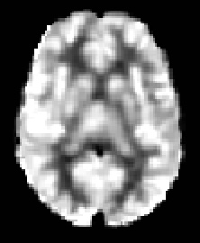
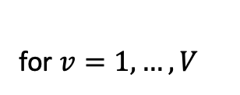
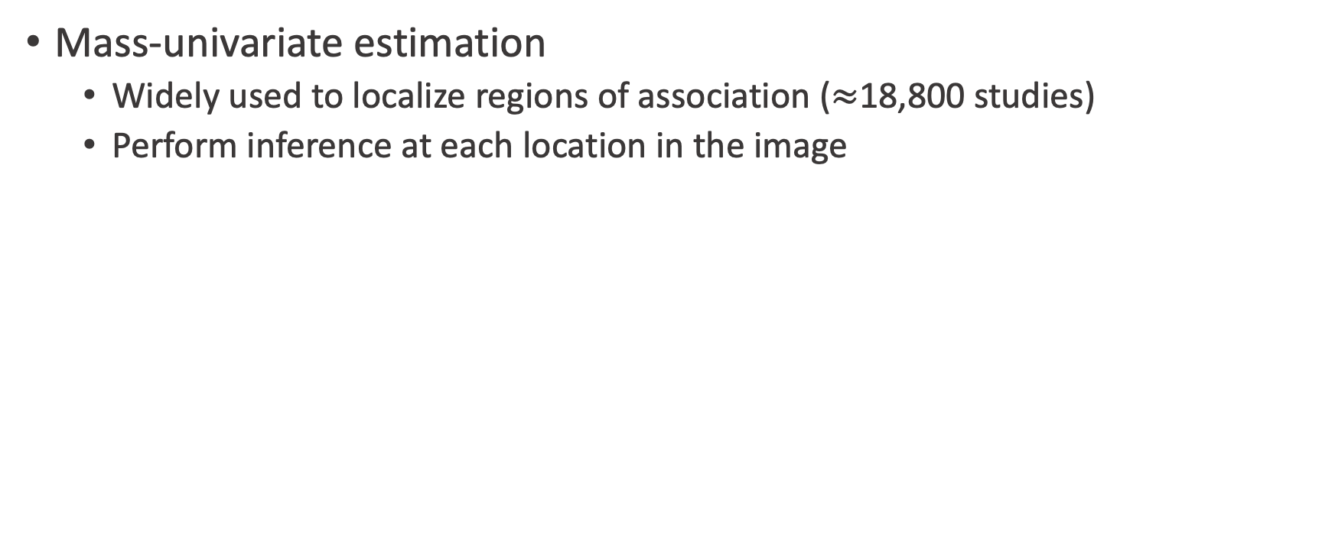
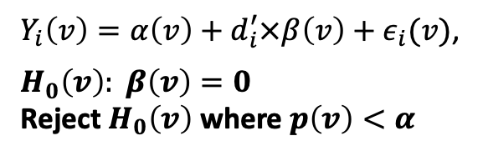
Mass-univariate approach
Mass-univariate estimation
Widely used to localize regions of association ($≈$18,800 studies)
Perform inference at each location in the image
Voxel
volumetric pixel
Y₁(v)
Y₂(v)
Y_{n}(v)
…
for $v=1,…, V$
$Y_{i}\left(v\right)=α\left(v\right)+d_{i}^{′}×β\left(v\right)+ε_{i}(v)$,
$$H_{0}\left(v\right): β\left(v\right)=0$$
Reject $H_{0}\left(v\right)$ where $p\left(v\right)<α$
Friston et al., Neuroimage, 1994
Nichols, http://blogs.warwick.ac.uk/nichols/entry/bibliometrics_of_cluster/, 2016

Slide 5
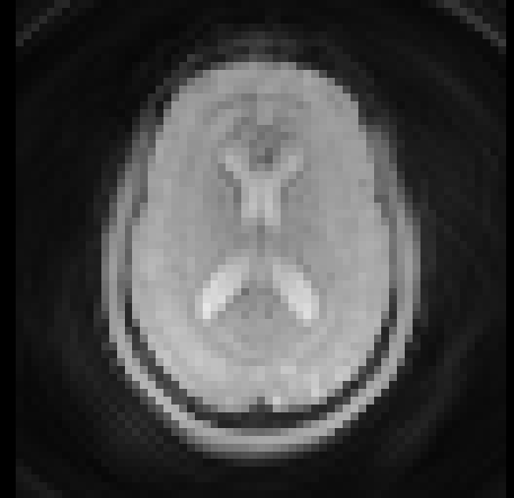
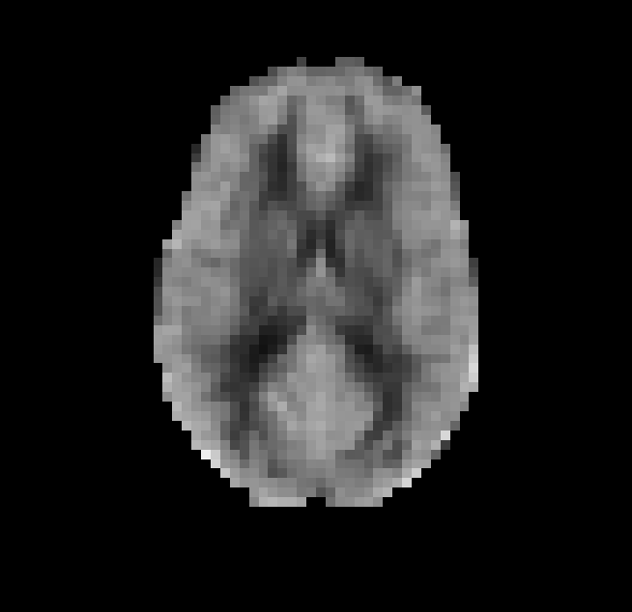
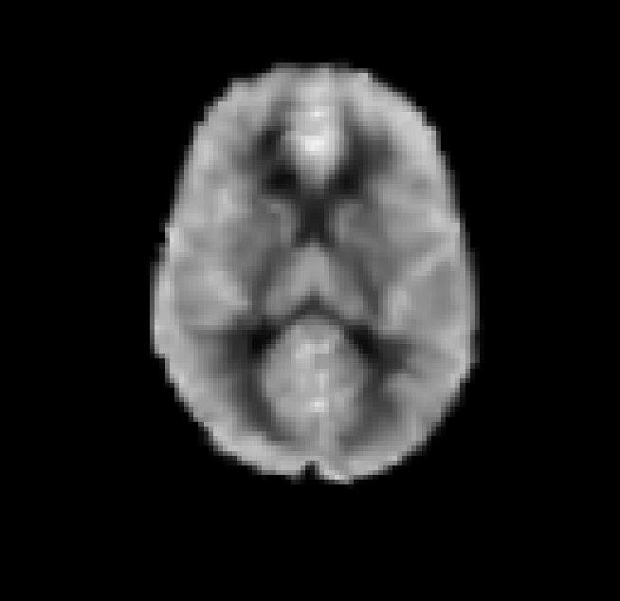
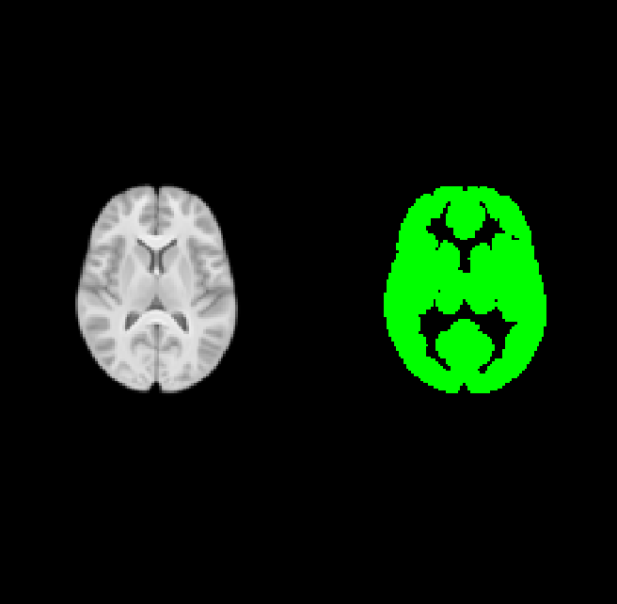
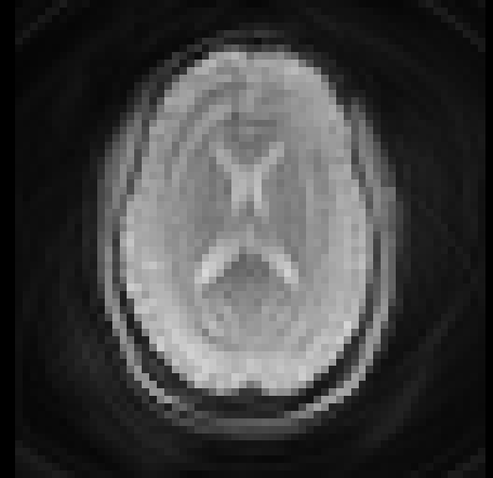
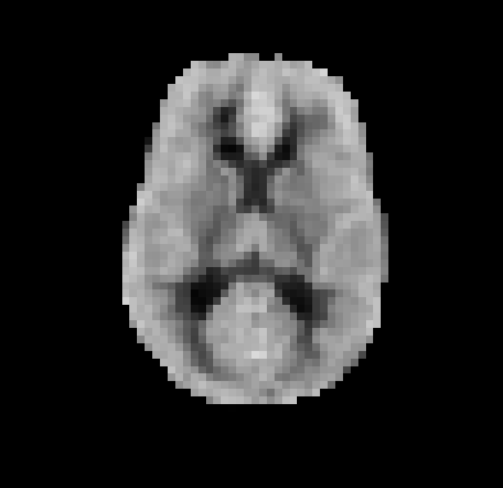
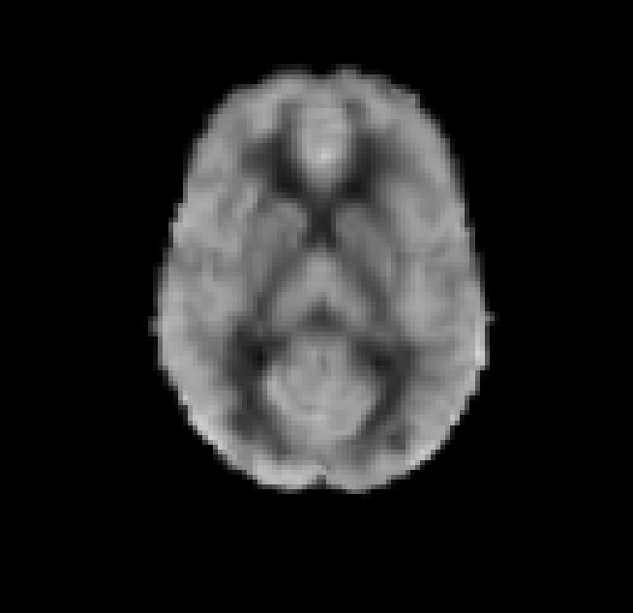
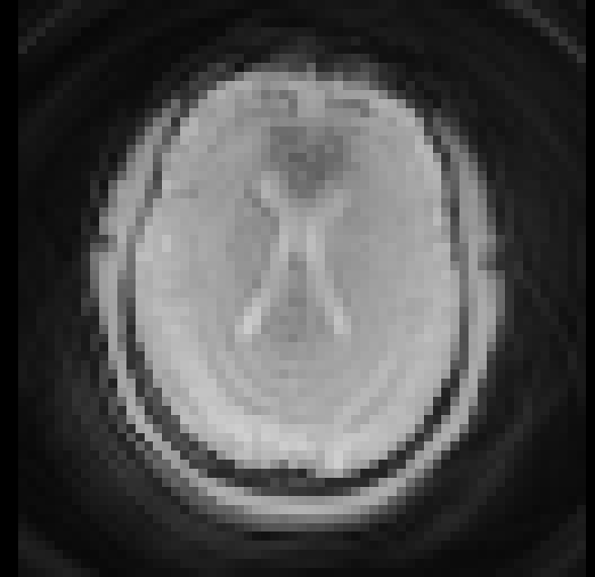
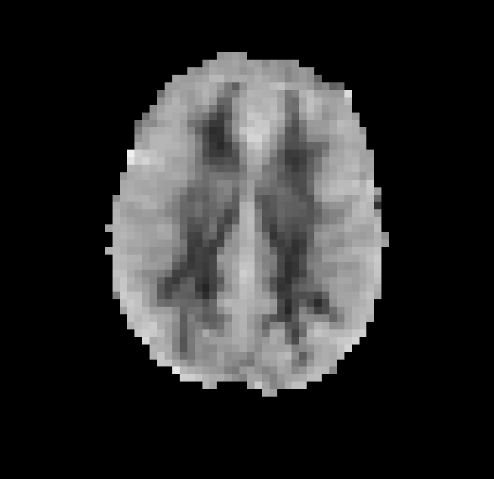
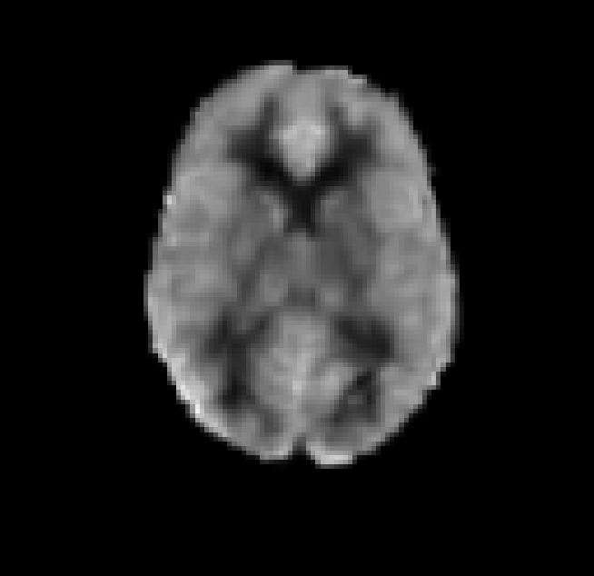
fMRI preprocessing steps
Unprocessed fMRI
Subject space fMRI
Template space fMRI
Y₁
Registration to
PNC template
Preprocessing:
distortion-correction, time-series preprocessing, rigid registration, brain extraction, temporal filtering, 6mm FWHM Gaussian spatial smoothing
Y₂
…
…
…
Y_{n}

Slide 6
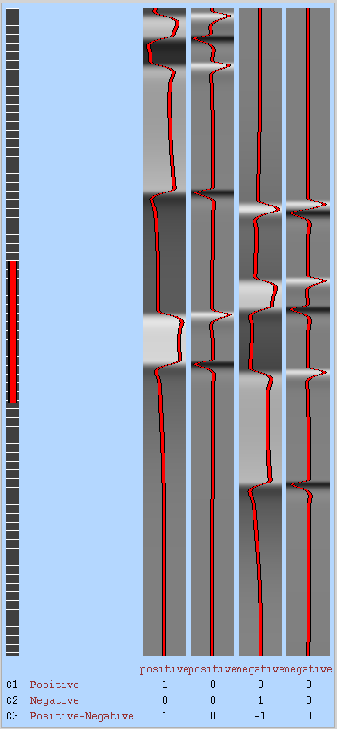

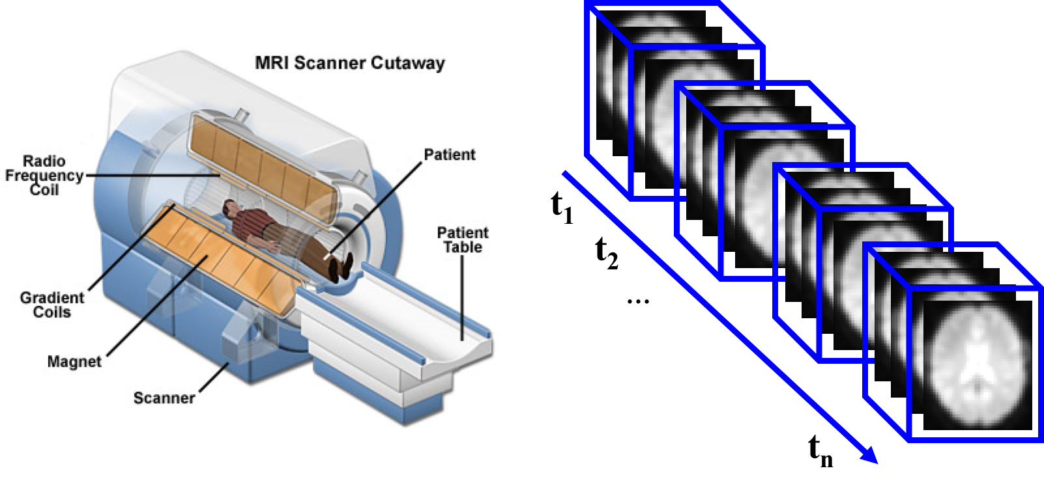
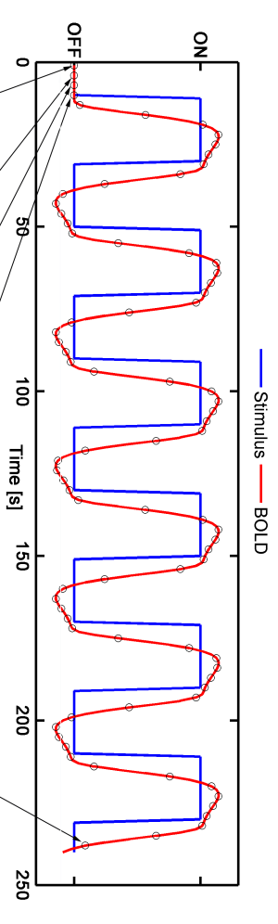
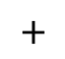
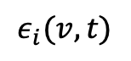
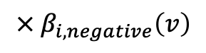
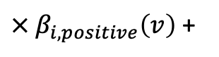
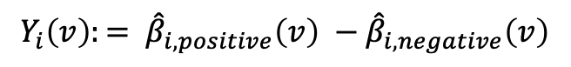
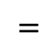
Despicable Me first-level analysis
Subject-level time series model:
$$=$$
${× β}_{i,positive}\left(v\right)$ +
$${× β}_{i,negative}\left(v\right)$$
$$+$$
$$ε_{i}(v,t)$$
Group-level analysis:
$${Y_{i}\left(v\right):= \hat{β}}_{i,positive}\left(v\right) −{\hat{β}}_{i,negative}\left(v\right)$$
Outcome is increased activation in 2-back condition

Slide 7
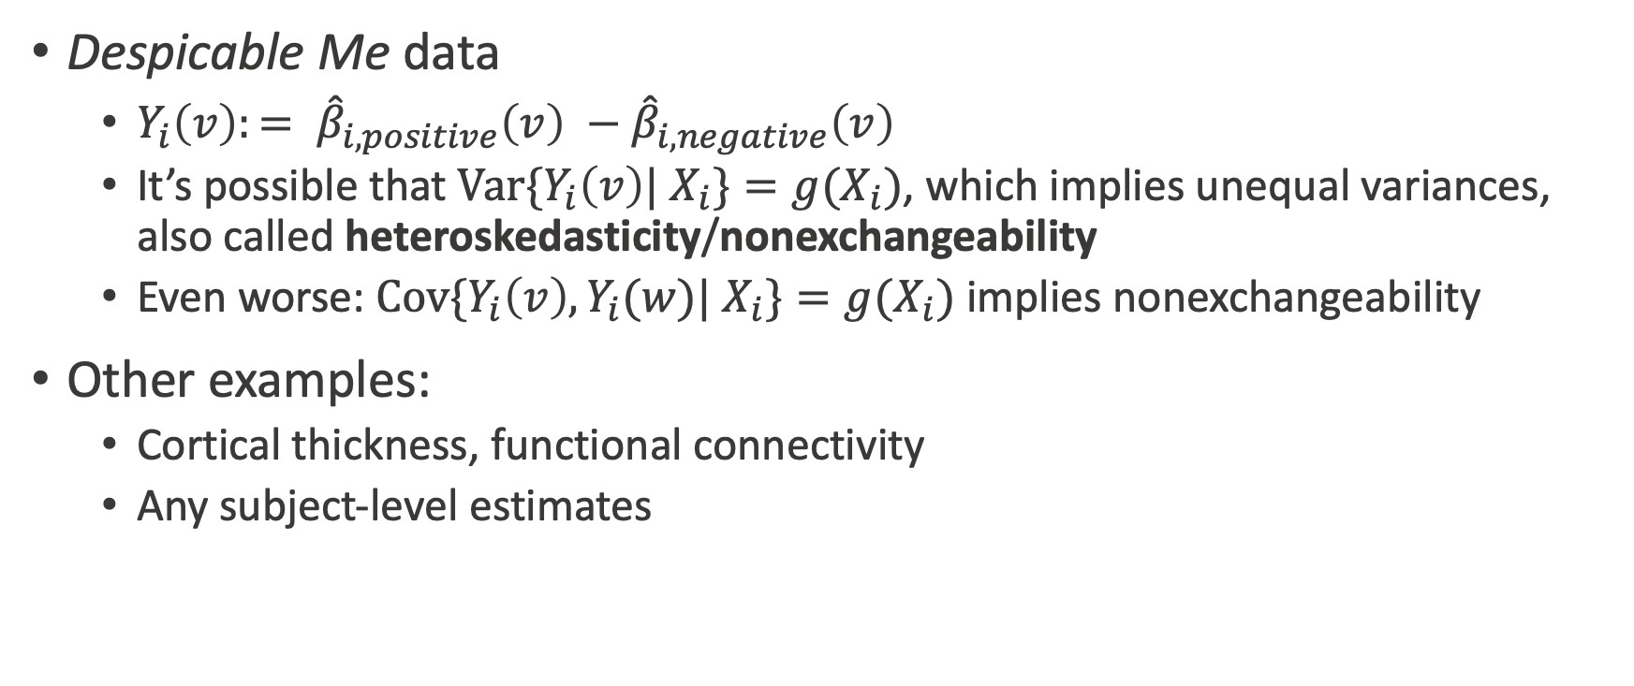
Heteroskedasticity in group-level analysis
Despicable Me data
${Y_{i}\left(v\right):= \hat{β}}_{i,positive}\left(v\right) −{\hat{β}}_{i,negative}\left(v\right)$
It’s possible that ${Var\{Y}_{i}\left(v\right)| X_{i}\}=g(X_{i})$, which implies unequal variances, also called heteroskedasticity/nonexchangeability
Even worse: ${Cov\{Y}_{i}\left(v\right), Y_{i}(w)| X_{i}\}=g(X_{i})$ implies nonexchangeability
Other examples:
Cortical thickness, functional connectivity
Any subject-level estimates

Slide 8
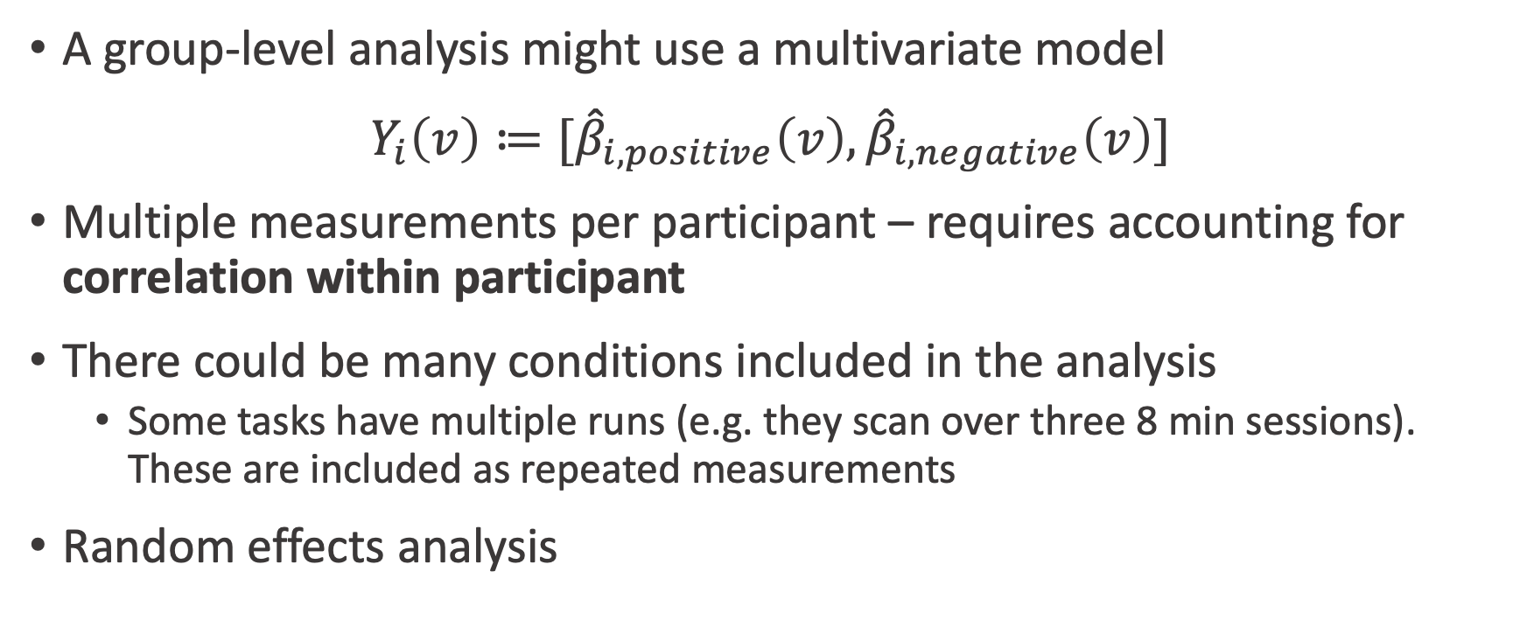
Multilevel models in neuroimaging
A group-level analysis might use a multivariate model
${Y_{i}\left(v\right)≔[\hat{β}}_{i,positive}\left(v\right), {\hat{β}}_{i,negative}\left(v\right)]$
Multiple measurements per participant – requires accounting for correlation within participant
There could be many conditions included in the analysis
Some tasks have multiple runs (e.g. they scan over three 8 min sessions). These are included as repeated measurements
Random effects analysis

Slide 9
Potential data structures
And appropriate methods
 |  | Variance Type
 |  | Homosked. | Heterosked.
Number of Measurements | One | Classical statistical methods | Variance weighted GLM; Robust standard errors (sPBJ)
 | Multiple | Random effects models | FLAME; GEE (sPBJ, SwE)

Slide 10
Options for group-level analysis
Classical approach – using linear model at group-level
Random effects analysis – with multiple measurements on the same participants
FLAME – random effects with heteroskedasticity
Semiparametric bootstrap joint inference (sPBJ) – research from my group. Correlated data with robust standard errors
Also implemented in SwE toolbox in SPM
Permutation testing

Slide 11
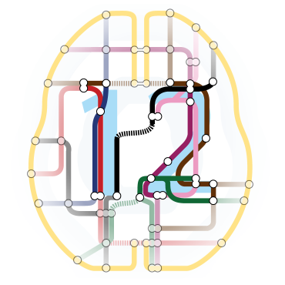


Comparing assumptions
 | GRF | FLAME | Permutation | sPBJ (our method)
Assumes homoskedasticity | 😩 | 😃/😩 | 😃/😩 | 😃
Uses normal approximations | 😩 | 😃 | 😃 | 😩/😃
Repeated measurements | 😃 | 😃 | 😩/😃 | 😃
Robust to model misspecification | 😩 | 😩 | 😩 | 😃
Uses some kind of approximation | 😩 | 😃/😩 | 😩 | 😩
*Methods overlap software packages, e.g. permutation is available in SPM and AFNI, but not as the default

Slide 12
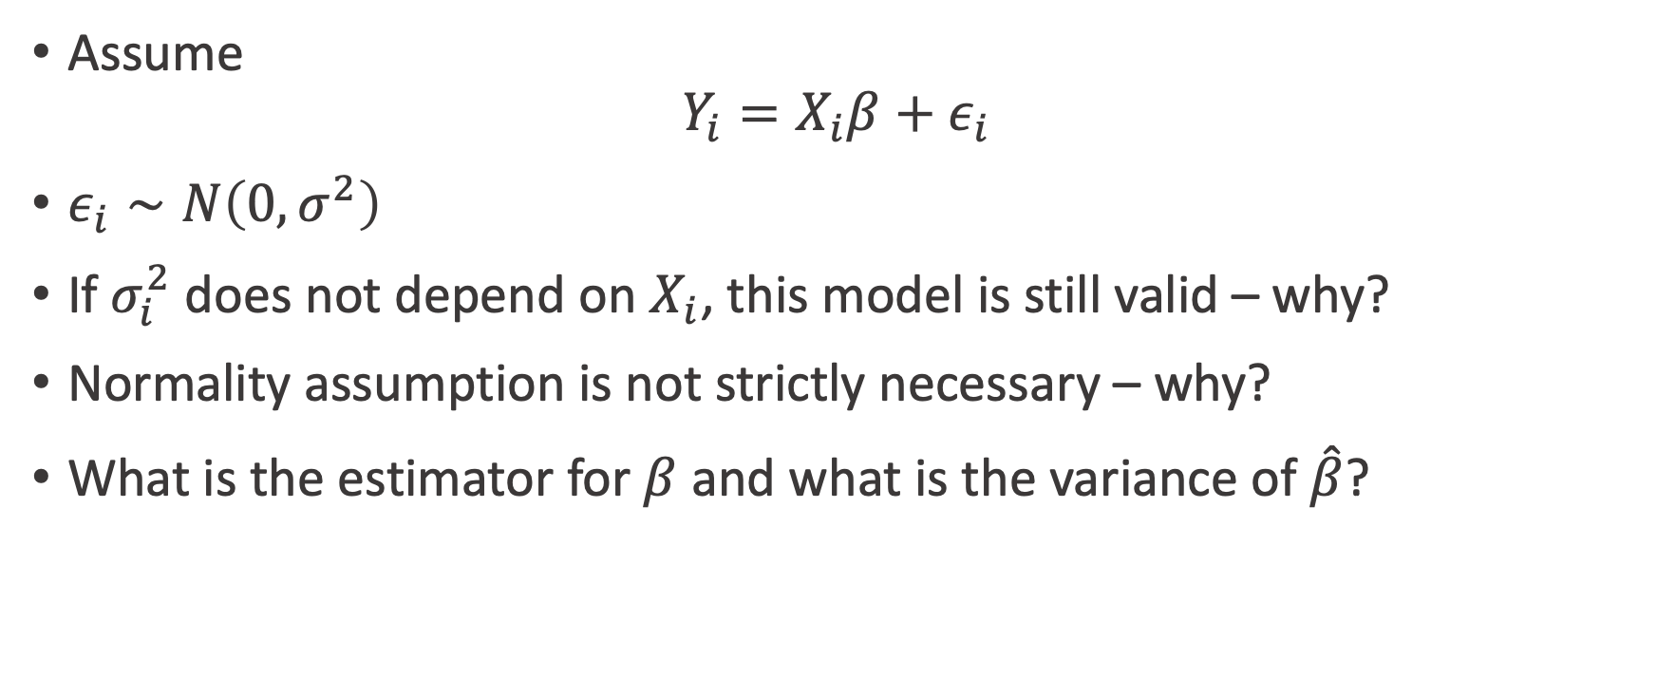
Classic approach – ignores first-level model
Assume
$$Y_{i}=X_{i}β+ε_{i}$$
$ε_{i}∼N\left(0, σ^{2}\right)$
If $σ_{i}^{2}$ does not depend on $X_{i}$, this model is still valid – why?
Normality assumption is not strictly necessary – why?
What is the estimator for $β$ and what is the variance of $\hat{β}$?

Slide 13
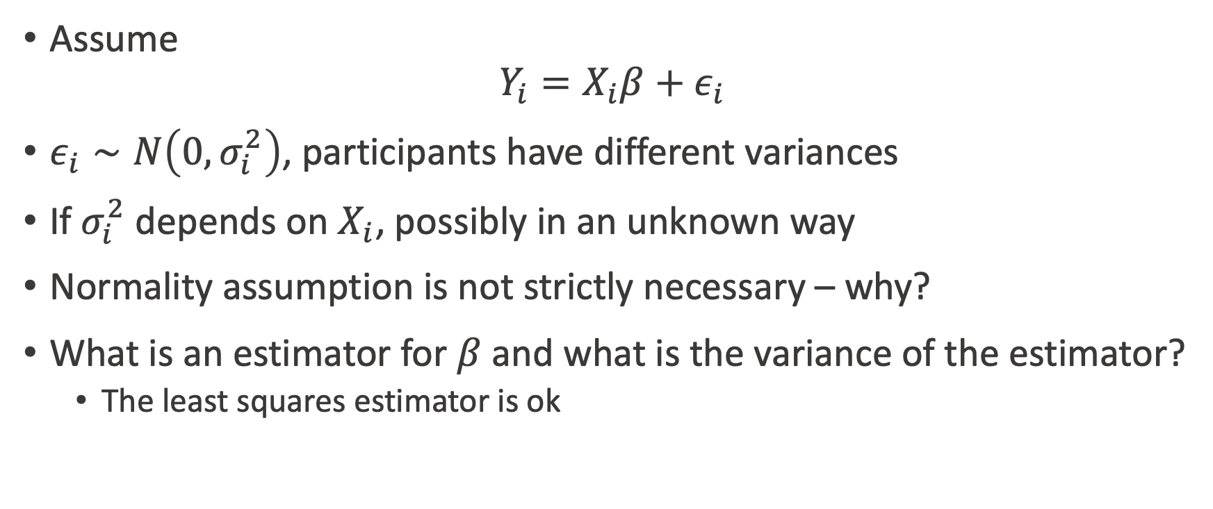
Robust (heteroskedasticity-consistent) standard errors approach
Assume
$$Y_{i}=X_{i}β+ε_{i}$$
$ε_{i}∼N\left(0, σ_{i}^{2}\right)$, participants have different variances
If $σ_{i}^{2}$ depends on $X_{i}$, possibly in an unknown way
Normality assumption is not strictly necessary – why?
What is an estimator for $β$ and what is the variance of the estimator?
The least squares estimator is ok

Slide 14
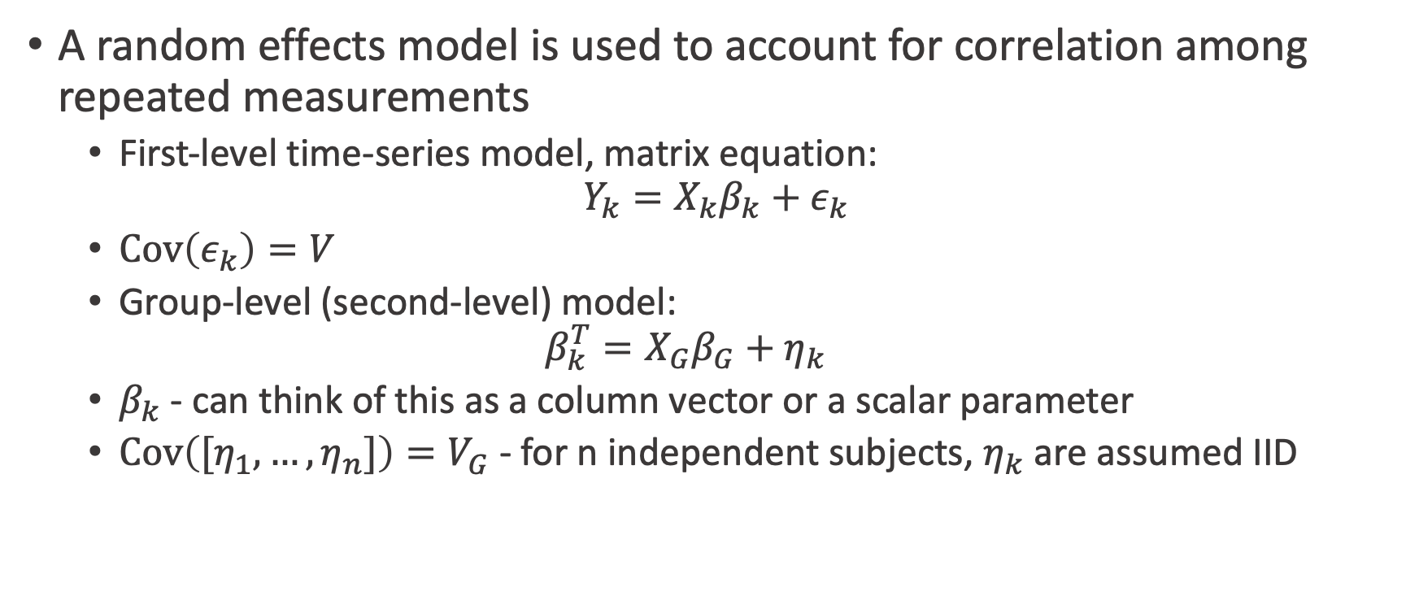
Multi-level (random effects) model
A random effects model is used to account for correlation among repeated measurements
First-level time-series model, matrix equation:
$$Y_{k}=X_{k}β_{k}+ε_{k}$$
$Cov\left(ε_{k}\right)=V$
Group-level (second-level) model:
$$β_{k}^{T}=X_{G}β_{G}+η_{k}$$
$β_{k}$ - can think of this as a column vector or a scalar parameter
$Cov\left({[η}_{1}, …, η_{n}]\right)=V_{G}$ - for n independent subjects, $η_{k}$ are assumed IID

Slide 15
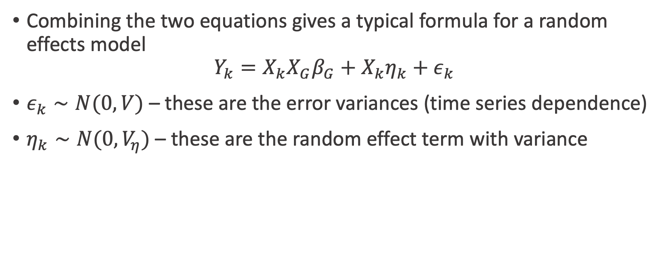
Combining the two equations
Combining the two equations gives a typical formula for a random effects model
$$Y_{k}=X_{k}X_{G}β_{G}+X_{k}η_{k}+ε_{k}$$
$ε_{k}∼N(0, V)$ – these are the error variances (time series dependence)
$η_{k}∼N(0,V_{η})$– these are the random effect term with variance

Slide 16
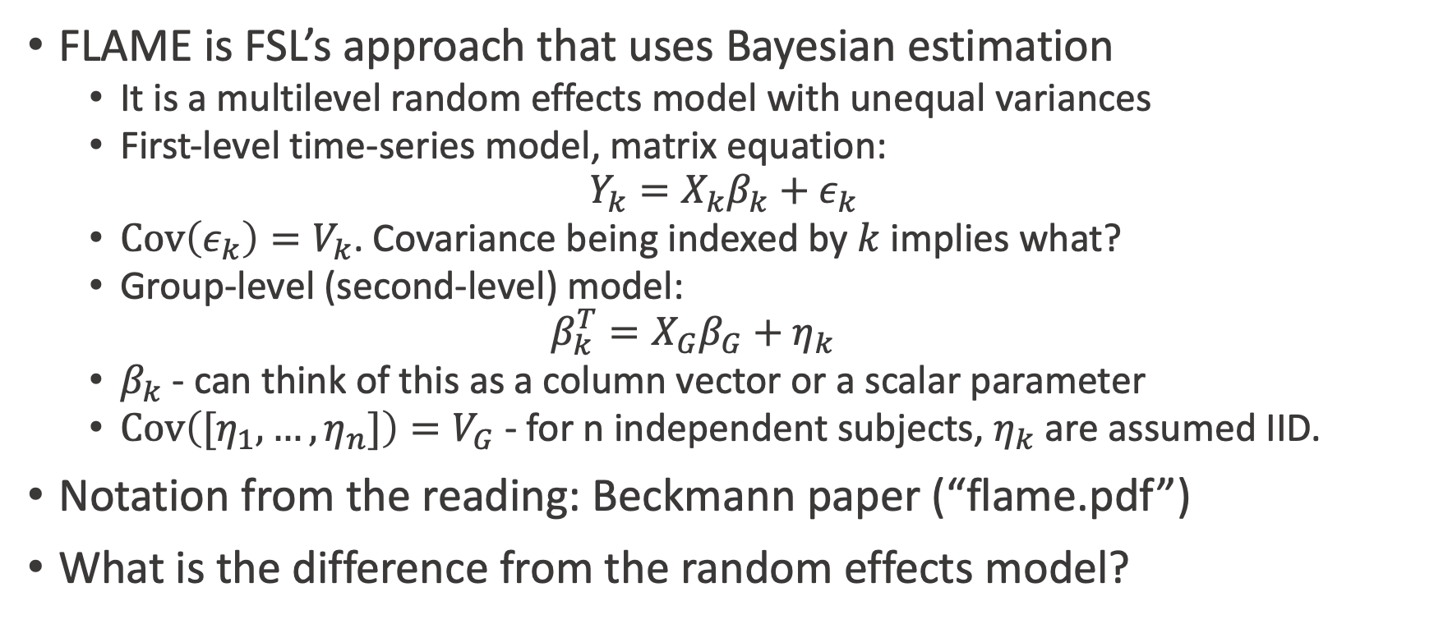
FLAME
FLAME is FSL’s approach that uses Bayesian estimation
It is a multilevel random effects model with unequal variances
First-level time-series model, matrix equation:
$$Y_{k}=X_{k}β_{k}+ε_{k}$$
$Cov\left(ε_{k}\right)=V_{k}$. Covariance being indexed by $k$ implies what?
Group-level (second-level) model:
$$β_{k}^{T}=X_{G}β_{G}+η_{k}$$
$β_{k}$ - can think of this as a column vector or a scalar parameter
$Cov\left({[η}_{1}, …, η_{n}]\right)=V_{G}$ - for n independent subjects, $η_{k}$ are assumed IID.
Notation from the reading: Beckmann paper (“flame.pdf”)
What is the difference from the random effects model?

Slide 17
FLAME estimation
Estimation is complex –occurs in multiple levels, which is convenient (Section 2.C of Beckmann paper)
More complex due to estimation of the variance terms

Slide 18
Semiparametric bootstrap joint (sPBJ) inference
This is what I called the “robust approach” on a previous slide and is essentially an imaging version of GEE
Can accommodate heteroskedasticity and longitudinal models
Uses “sandwich” covariance estimates for asymptotically unbiased spatial covariance function estimator

Slide 19
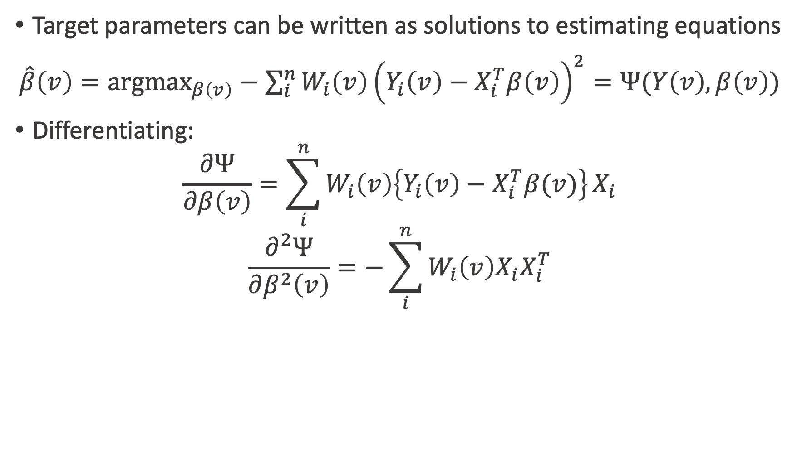
Estimating equations approach
Target parameters can be written as solutions to estimating equations
$\hat{β}\left(v\right)=argmax_{β\left(v\right)}−{\sum_{i}^{n}{W_{i}\left(v\right)\left(Y_{i}\left(v\right)−X_{i}^{T}β\left(v\right)\right)}}^{2}=Ψ(Y\left(v\right), β\left(v\right))$
Differentiating:
$$\frac{∂Ψ}{∂β\left(v\right)}=\sum_{i}^{n}{W_{i}\left(v\right)\left\{Y_{i}\left(v\right)−X_{i}^{T}β(v)\right\}}X_{i}$$
$$\frac{∂^{2}Ψ}{∂β^{2}\left(v\right)}=−\sum_{i}^{n}{W_{i}\left(v\right)X_{i}X_{i}^{T}}$$

Slide 20
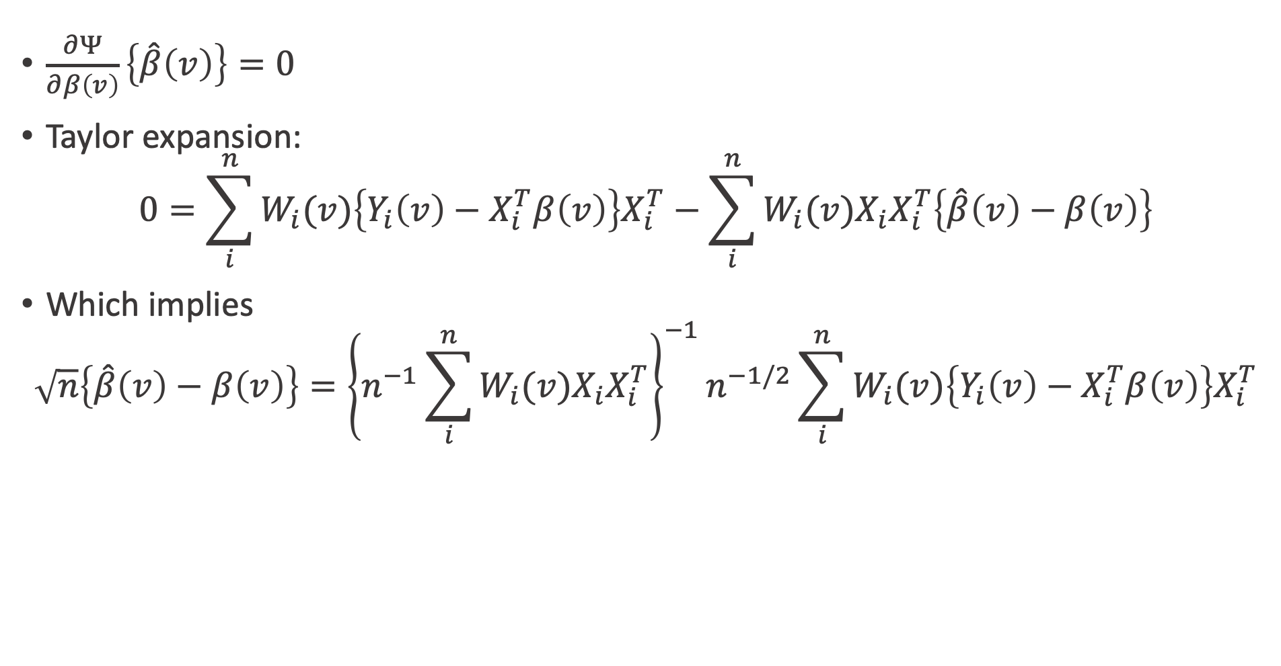
Taylor expansion of estimating equation
$\frac{∂Ψ}{∂β\left(v\right)}\left\{\hat{β}\left(v\right)\right\}=0$
Taylor expansion:
$$0=\sum_{i}^{n}{W_{i}(v)\left\{Y_{i}\left(v\right)−X_{i}^{T}β\left(v\right)\right\}X_{i}^{T}}−\sum_{i}^{n}{W_{i}(v)X_{i}X_{i}^{T}\left\{\hat{β}\left(v\right)−β\left(v\right)\right\}}$$
Which implies
$$\sqrt{n}\left\{\hat{β}\left(v\right)−β\left(v\right)\right\}={\left\{n^{−1}\sum_{i}^{n}{W_{i}(v)X_{i}X_{i}^{T}}\right\}}^{−1}n^{−1/2}\sum_{i}^{n}{W_{i}(v)\left\{Y_{i}\left(v\right)−X_{i}^{T}β\left(v\right)\right\}X_{i}^{T}}$$

Slide 21
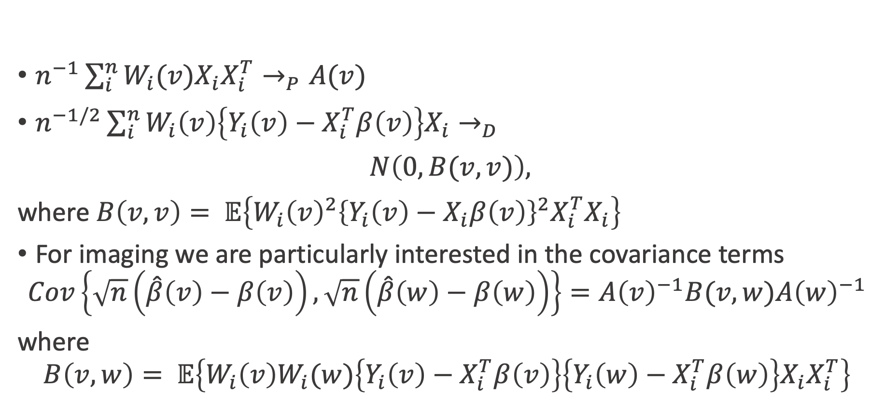
Asymptotic joint distribution
$n^{−1}\sum_{i}^{n}{W_{i}(v)X_{i}X_{i}^{T}}→_{P}A(v)$
$n^{−1/2}\sum_{i}^{n}{W_{i}\left(v\right)\left\{Y_{i}\left(v\right)−X_{i}^{T}β\left(v\right)\right\}X_{i}→_{D}}$
$N\left(0, B(v, v)\right),$
where $B\left(v, v\right)= 𝔼\left\{W_{i}{\left(v\right)}^{2}{\left\{Y_{i}\left(v\right)−X_{i}β\left(v\right)\right\}}^{2}X_{i}^{T}X_{i}\right\}$
For imaging we are particularly interested in the covariance terms
$$Cov\left\{\sqrt{n}\left(\hat{β}\left(v\right)−β\left(v\right)\right),\sqrt{n}\left(\hat{β}\left(w\right)−β\left(w\right)\right)\right\}=A{\left(v\right)}^{−1}B(v, w)A{\left(w\right)}^{−1}$$
where
$$B\left(v, w\right)= 𝔼\left\{W_{i}\left(v\right)W_{i}(w)\left\{Y_{i}\left(v\right)−X_{i}^{T}β\left(v\right)\right\}\left\{Y_{i}\left(w\right)−X_{i}^{T}β\left(w\right)\right\}{X_{i}X}_{i}^{T}\right\}$$

Slide 22
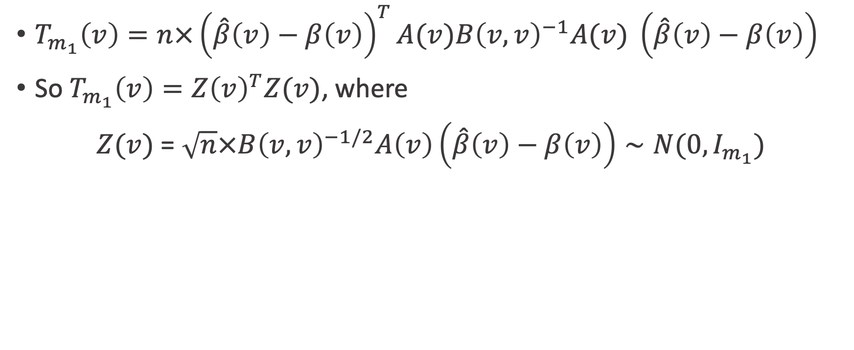
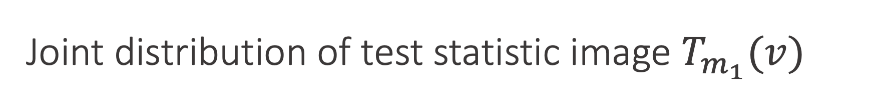
Joint distribution of test statistic image $T_{m_{1}}(v)$
$T_{m_{1}}\left(v\right)=n×{\left(\hat{β}\left(v\right)−β\left(v\right)\right)}^{T}A(v)B{\left(v,v\right)}^{−1}A(v) \left(\hat{β}\left(v\right)−β\left(v\right)\right)$
So $T_{m_{1}}\left(v\right)=Z{\left(v\right)}^{T}Z(v)$, where
$Z(v)$ = $\sqrt{n}×B{\left(v,v\right)}^{−1/2}A\left(v\right)\left(\hat{β}\left(v\right)−β\left(v\right)\right)∼N(0,I_{m_{1}})$

Slide 23
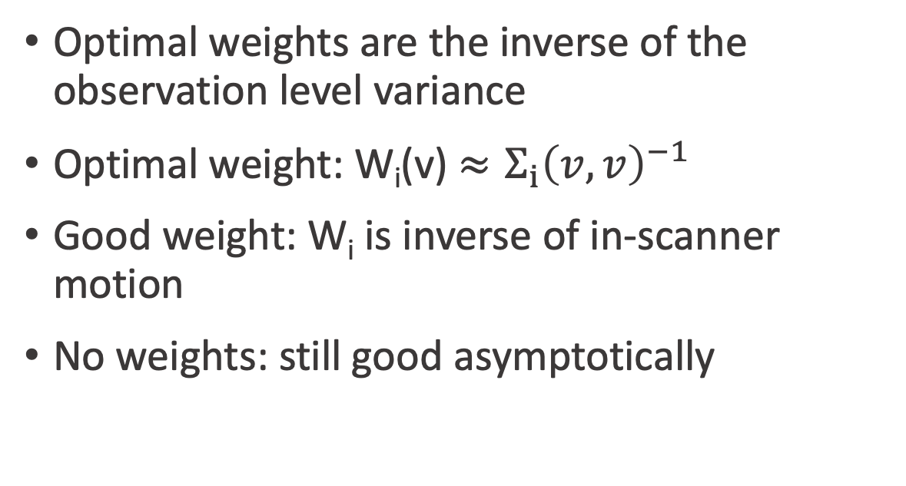
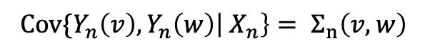
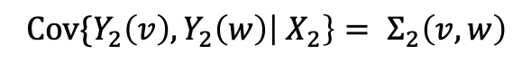
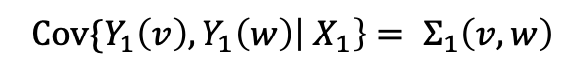
Choosing subject weights for the sPBJ
Optimal weights are the inverse of the observation level variance
Optimal weight: W_{i}(v) $≈Σ_{i}{\left(v,v\right)}^{−1}$
Good weight: W_{i} is inverse of in-scanner motion
No weights: still good asymptotically
Y₁(v)
$${Cov\{Y}_{1}\left(v\right), Y_{1}\left(w\right)\left| X_{1}\right\}= Σ_{1}\left(v,w\right)$$
Y₂(v)
$${Cov\{Y}_{2}\left(v\right), Y_{2}\left(w\right)\left| X_{2}\right\}= Σ_{2}\left(v,w\right)$$
…
Y_{n}(v)
$${Cov\{Y}_{n}\left(v\right), Y_{n}\left(w\right)\left| X_{n}\right\}= Σ_{n}\left(v,w\right)$$

Slide 24
Some computational practicalities
Estimation in neuroimaging often occurs in parallel across all locations
Statistical Inference accounts for correlation among voxels

Slide 25
Statistical Inference

Slide 26
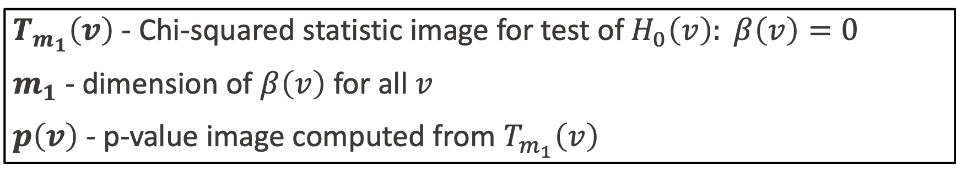
Notation
$T_{m_{1}}\left(v\right)$ - Chi-squared statistic image for test of$H_{0}\left(v\right): β\left(v\right)=0$
$m_{1}$ - dimension of $β\left(v\right)$ for all $v$
$p\left(v\right)$ - p-value image computed from $T_{m_{1}}\left(v\right)$

Slide 27
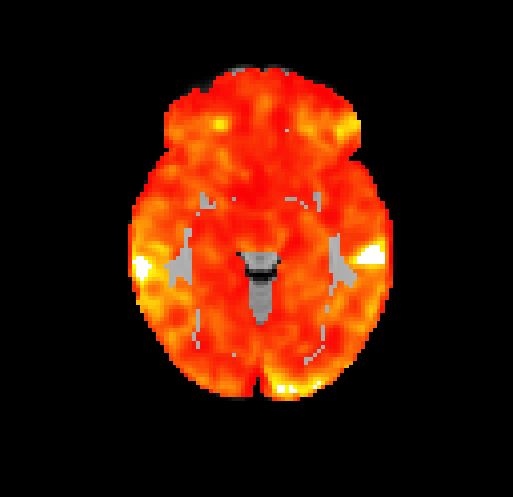
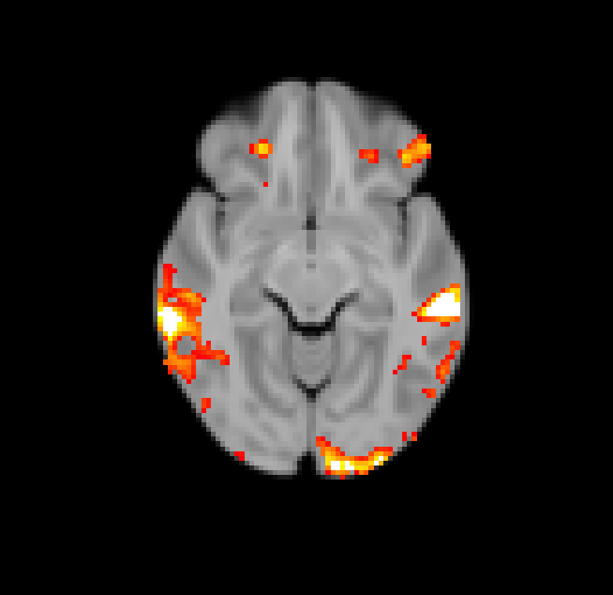
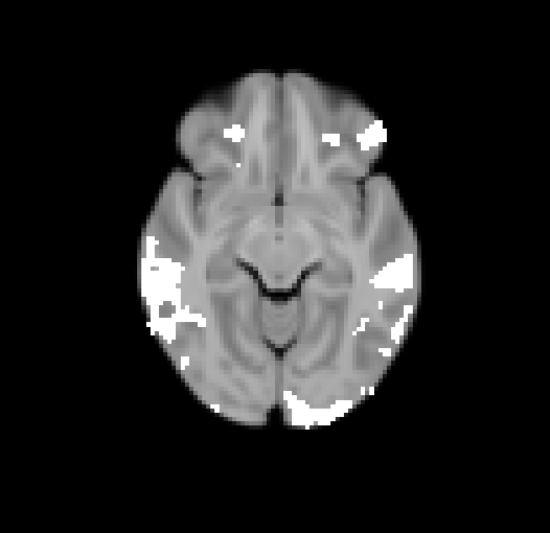
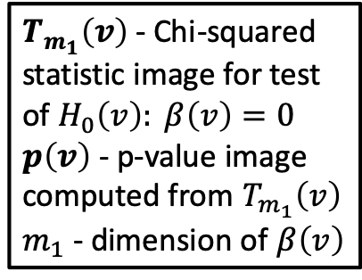
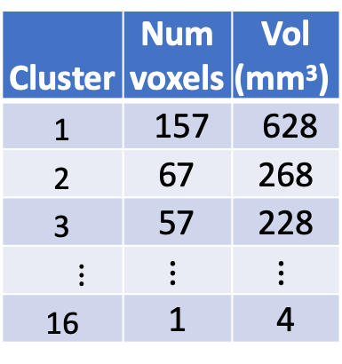
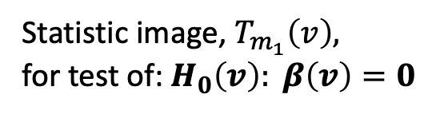
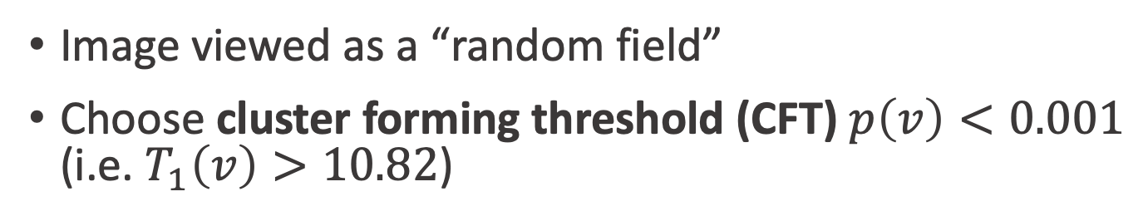
Spatial extent inference procedure
$T_{m_{1}}\left(v\right)$ - Chi-squared statistic image for test of$H_{0}\left(v\right): β\left(v\right)=0$
$p\left(v\right)$ - p-value image computed from $T_{m_{1}}\left(v\right)$
$m_{1}$ - dimension of $β\left(v\right)$
Cluster | Num voxels | Vol (mm³)
1 | 157 | 628
2 | 67 | 268
3 | 57 | 228
$⋮$ | $$⋮$$ | $$⋮$$
16 | 1 | 4
Threshold stat image
(CFT)
Binarize thresholded stat image
Compute cluster statistics
Statistic image, $T_{m_{1}}\left(v\right),$
for test of:$H_{0}\left(v\right): β\left(v\right)=0$
Image viewed as a “random field”
Choose cluster forming threshold (CFT) $p\left(v\right)<0.001$ (i.e. $T_{1}\left(v\right)>10.82$)

Slide 28
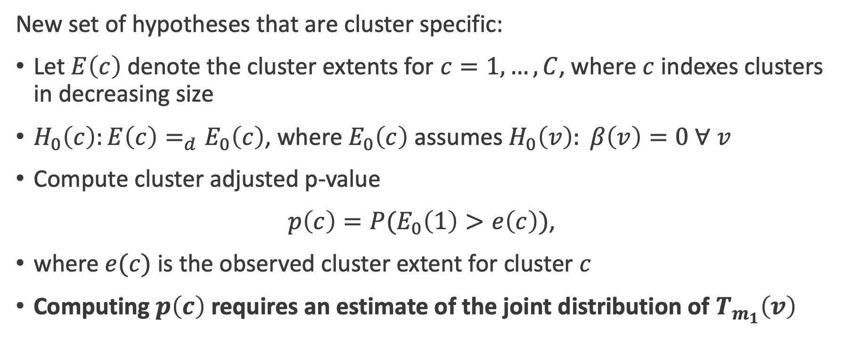
Spatial extent inference p-values
$T_{m_{1}}\left(v\right)$ - Chi-squared statistic image for test of$H_{0}\left(v\right): β\left(v\right)=0$
$p\left(v\right)$ - p-value image computed from $T_{m_{1}}\left(v\right)$
$m_{1}$ - dimension of $β\left(v\right)$
New set of hypotheses that are cluster specific:
Let $E\left(c\right)$ denote the cluster extents for $c=1,…, C$, where $c$ indexes clusters in decreasing size
$H_{0}\left(c\right):E\left(c\right)=_{d}E_{0}\left(c\right)$, where $E_{0}\left(c\right)$ assumes $H_{0}\left(v\right): β\left(v\right)=0 ∀$ $v$
Compute cluster adjusted p-value
$p\left(c\right)=P(E_{0}\left(1\right)>e\left(c\right))$,
where $e(c)$ is the observed cluster extent for cluster $c$
Computing $p\left(c\right)$ requires an estimate of the joint distribution of $T_{m_{1}}\left(v\right)$

Slide 29
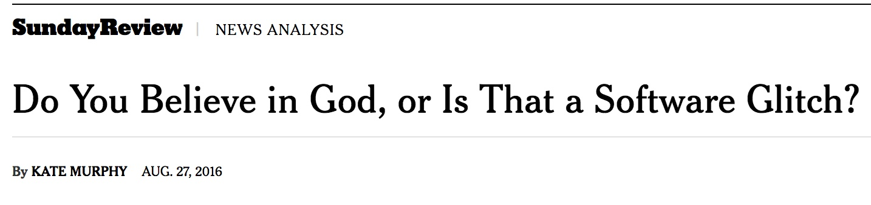



Problem: inflated FWER in neuroimaging
Standard mass-univariate tools have inflated FWER
Unrealistic assumptions about covariance structure

Slide 30

Unrealistic assumptions in SEI
Classical methods for SEI rely on smooth Gaussian random field approximations
GRF approximations only work under very restrictive assumptions
Many papers on this:
Silver 2011, Woo 2014, Eklund 2016, Flandin 2016, Slotnick 2017, Cox 2017, Kessler 2017, Mueller 2017, Greve 2018
Cox et al., Brain Connectivity, 2017

Slide 31

Permutation tests work quite well
Permutation testing maintains nominal FWER
Limitation: requires exchangeability – cannot accommodate multilevel models or heteroskedasticity
Our methodological goal is to develop a inference procedure appropriate for multilevel models
Greve & Fischl, Neuroimage, 2018

Slide 32

Philadelphia Neurodevelopmental Cohort (PNC)¹
Cohort study to investigate genetic and imaging risk factors associated with psychiatric disorders
Led by Raquel Gur and Hakon Hakonarson
Cross-sectional N-back data 1,600 volunteers ages 8-23
n | % female | Age (SD) | Age range
1000 | 55% | 14.7 (3.5) | 8-23
¹Satterthwaite et al., Neuroimage, 2016

Slide 33


N-back data analysis
We analyzed a subset of 1000 subjects imaged as part of the Philadelphia Neurodevelopmental Cohort
Our scientific goal is to understand how activation associated with increasing working memory load is related to task performance
Our null hypothesis at $v$ is $H_{0}\left(v\right): β\left(v\right)=0$
$$Y_{i}\left(v\right)=α_{0}\left(v\right)+α_{1}\left(v\right)×{sex}_{i}+α_{2}\left(v\right)× {age}_{i}+α_{3}\left(v\right)×{mot}_{i}$$
$$+β\left(v\right) × d_{i}^{′}+ε_{i}(v)$$
Satterthwaite et al., J Neuro, 2013

Slide 34


Simulating realistic heteroskedasticity
To generate realistic heteroskedasticity we bootstrapped from N-back data
In a subset of 1000 subject from the PNC, we fit the model
The sample mean of ${\hat{ε} }_{i}(v)$ is then independent of the covariates
The covariance function $Cov\{{\hat{ε} }_{i}\left(v\right),{\hat{ε} }_{i}\left(w\right)\}$ may be affected by covariates
$$Y_{i}\left(v\right)=α_{0}\left(v\right)+α_{1}\left(v\right)×{sex}_{i}$$
$$+f\left(v, {age}_{i}\right)+g\left(v, {mot}_{i}\right)+h\left(v, d_{i}^{′}\right)+ε_{i}(v)$$

Slide 35

The covariance function is affected by covariates in the N-back sample
${Cov\{Y}_{i}\left(v\right), Y_{i}\left(w\right)\left| X_{i}\right\}≠{Cov\{Y}_{j}\left(v\right), Y_{j}\left(w\right)\left| X_{j}\right\}$ implies heteroskedasticity

Slide 36


Intuition behind simulation procedure
Treat residuals ${\hat{ε} }_{i}(v)$ of 1000 subjects as population under the null
In each simulation draw a bootstrap sample and fit the model
Perform test of $H_{0}\left(v\right): β_{b}\left(v\right)=0$and $H_{0}\left(v\right): α_{3b}\left(v\right)=0$to assess effect of heteroskedasticity on FWER of SEI procedures
$${\hat{ε} }_{ib}\left(v\right)=α_{0b}\left(v\right)+α_{1b}\left(v\right)×{sex}_{ib}+α_{2b}\left(v\right)× {age}_{ib}+α_{3b}\left(v\right)×{mot}_{ib}$$
$$+β_{b}\left(v\right) × d_{ib}^{′}+ε_{ib}(v)$$

Slide 37

Procedures we will compare
GRF - classical GRF based method assuming local correlation in field
Perm - permutation procedure assumes exchangeability
Perm Grp - permutation procedure, attempts to adjust for non exchangeability
PBJ - parametric bootstrap joint procedure [PBJ(1), PBJ(mot)]
sPBJ - semiparametric bootstrap joint procedure [sPBJ(1), sPBJ(mot)]
Friston et al., Neuroimage, 1996
Winkler et al., Neuroimage, 2014
Winkler et al., Neuroimage, 2015
Vandekar et al., Biometrics, 2019

Slide 38
Heteroskedasticity simulation: type 1 error rates
For the test of the motion covariate
GRF near 100% error rate
Permutations and unweighted PBJ have inflated error rate
Robust methods have near nominal performance at less conservative CFTs
For the test of the d’ covariate
GRF still quite high
Other methods near or approach nominal level
Next slide: power analysis
Vandekar et al., Biometrics, 2019

Slide 39
Heteroskedasticity simulation: power results
CFT=0.01
CFT=0.001
Power results for the test of the d’ covariate for a rejection threshold of 0.01
Type 1 error rates near the nominal level
Motion deweighting may improve power here

Slide 40
N-back data analysis
We used a random subset of 200 subjects to evaluate the different procedures
Recall our goal: to identify regions where WM performance is associated with WM activation
The PBJ and sPBJ procedures used voxel-wise weights proportional to the inverse of the subject variance image estimates.
Use SEI to compute p-values for each cluster

Slide 41

N-back data analysis results
Perm
The sPBJ have smaller p-values in some regions
Small p-values indicate cluster sizes that are unlikely under the global null $H_{0}\left(v\right): β_{b}\left(v\right)=0$, for all $v$
PBJ
sPBJ
-log₁₀(p)

Slide 42

The covariance function is affected by covariates in the N-back sample
${Cov\{Y}_{i}\left(v\right), Y_{i}\left(w\right)\left| X_{i}\right\}≠{Cov\{Y}_{j}\left(v\right), Y_{j}\left(w\right)\left| X_{j}\right\}$ implies heteroskedasticity
Functional connectivity is evidence of heteroskedasticity

